Slide 1
Introducing SharePoint 2010

Slide 2
Agenda
Introducing SharePoint
Logging in and Getting Around
SharePoint Components
Notes:
In this module, you will learn to log onto and navigate a Microsoft SharePoint 2010 Web site. We will discuss various features of a SharePoint site that are useful to information workers and explore the predominant lists, libraries and sub-sites employed by business users to organize, share, and communicate about company information.
The intended audience for this course are business users and information workers who access SharePoint web sites via a web browser application to organize and manage data or communicate with others. While previous experience working in SharePoint (any version) is a plus, it is not a required prerequisite for this material. General web surfing skills, however, are needed to keep up with the timed lab work.

Slide 3
Introducing SharePoint
The purpose of community-based systems
Business Needs addressed by SharePoint
Interface and Features
Notes:
Before you can understand SharePoint from a user perspective, it’s important to realize the value your SharePoint environment brings to your team, your department and your company.
Community-based systems offer a central location for locating and working with business information as well as communicating with co-workers.
SharePoint is a secure web-based community platform that is easily navigated via hyperlinks in an Internet Browser application like Internet Explorer or quickly accessed from Microsoft Office applications. Users who authenticate to the system gain access to valuable business information according to their authority.
Information workers can take advantage of Features such as lists, libraries, workspaces, blogs, wikis, and workflows to organize data and communicate with their team members. To enhance each individual’s productivity, business users can also personalize the SharePoint sites they visit often.

Slide 4
Community Based Systems
Increase Productivity
Dynamic Adaptation
Better Communication
Cost Reduction
Common Goals
Notes:
Community Based Systems address a myriad of business needs:
Increased Productivity: business users work smarter, not harder
Dynamic Adaptation: the system can react to changes in business needs more efficiently
Cost Reduction: bigger returns on smaller investments
Improved Communication: global business users communicate in real-time about community data
Common Goals: unifies business users toward a single goal while instilling ownership and accountability
The overall benefit of successfully fulfilling these business needs is a more productive and efficient workforce, which translates into lower operation costs and, hopefully, higher profits for the company.

Slide 5
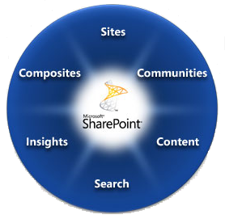
SharePoint 2010 Capability Areas
Notes:
The SharePoint 2010 Community Based System provides six areas of recognizable benefits for information workers. Each of these areas is referred to as a workload. The six workloads are sites, composites, communities, content, search and insights.

Slide 6
Agenda
Introducing SharePoint
Logging in and Getting Around
SharePoint Components

Slide 7
Logging In and Getting Around
Authentication vs. Authorization
Sign In … Sign Out
Navigation Tools
Notes:
As a SharePoint user, it’s important for you to know how to sign-in to your SharePoint site and move around if you plan to use anything in it!
You also need to understand the mechanisms that SharePoint uses to protect the data from unauthorized use. Specifically, the methodologies of authentication and authorization. There is a difference between authenticating to a SharePoint site and authorizing use of the SharePoint objects and data within SharePoint.
Once signed in, finding your way through the myriad of web pages in a site or traversing between sites can be a challenge. Luckily SharePoint 2010 ships with several tools to help you navigate a site and its pages.

Slide 8
Accessing SharePoint
AUTHENTICATION
AUTHORIZATION
Windows
Forms-Based (FBA)
SAML/Token
Principals
Securables
Permissions
Notes:
Accessing a SharePoint web site page can only be successfully accomplished by authorized users (unless the site is configured to allow anonymous access). Authorized users make it through two levels of security before arriving onto the web page in their browser application:
Authentication: The verification of one’s identity…proving you are who you say you are!
Authorization: The determination of one’s level of access to certain objects or data in SharePoint based on one’s authenticated identity
SharePoint Server 2010 can verify users across multiple authentication platforms:
- Windows: Can be either an ADS user account or a local user account from the Windows OS on the SharePoint server
- Forms-Based (FBA): Programmers can create custom logon web pages where users enter a unique user name and password
- SAML/Token-Based: Smart cards, badges, and other logon methods are supported via Windows Identity Foundation
Once authenticated, a business user’s level of access to SharePoint sites, pages and content is based on their identity’s authorization level. SharePoint uses its own architecture to employ permissions:
- Principals: SharePoint users and groups that will be given authority to a resource
- Securables: SharePoint sites, pages, lists/libraries, folders, and items to which principals will be granted authority
- Permissions: Varying levels of authority that provide the recipient principal the ability to view or manage SharePoint securables
- Permission Levels: Pre-defined collections of individual permissions that can be granted to principals and provide them the necessary authority to perform certain actions in SharePoint (such as contribute items to lists or design the site pages).

Slide 9
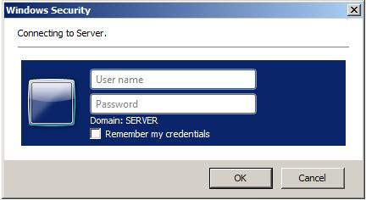
Windows Authentication
Windows Authentication logon dialog box
Notes:
When SharePoint is configured to use Windows Authentication for a site, information workers may experience a logon prompt when they attempt to access the site from a client application (such as an Internet browser or Microsoft Office application).
However, administrators can configure the Internet Explorer web browsing application to recognize the SharePoint site’s URL as belonging to the Intranet security zone which, by default, bypasses the logon prompt and transparently forwards the user’s locally logged-on Windows User Account information to the SharePoint server. Similarly, administrators can configure Microsoft Office applications like Word or Excel to also transparently forward the user’s locally logged-on Windows User Account information to eliminate the Windows Security logon prompt when access SharePoint content from an Office application.
When entering the User name value, users can supply just their domain user account name or enter both the domain name and user account information in one of two formats: NTDS or UPN.
NTDS: {NetBIOS or Fully Qualified DNS domain name}\{user name}
For example: Wingtip\Bob or Wingtip.com\Bob
UPN: {user name}@{Fully Qualified DNS domain name}
For example: Bob@Wingtip.com
NOTE: The “Remember my credentials” checkbox is a function of Internet Explorer and will save the entered user name and password values within IE. If a user engages this feature, they will need to remember to manage the saved credential in Internet Explorer every time they change their Windows logon password.

Slide 10
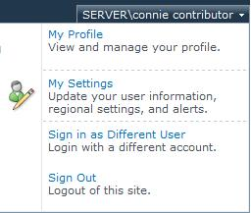
SharePoint Welcomes You!
Notes:
Once authenticated, SharePoint’s browser user interface welcomes the logged on user name credential and provides a menu of authentication and personalization options:
My Profile – allows you to view your public profile in SharePoint…the information other users can see about you…as well as edit your profile values
My Settings – can be used to view your user information and manage regional preferences (such as language choices) and alerts
Sign in as Different User – logs you off the SharePoint site without closing the page or the web browser application then prompts for a different logon user name and password which, once provided, may change the appearance of the web page based on the newly authenticated user’s permissions.
Sign Out – logs you off the SharePoint site which, unless the site allows anonymous access, will result in a warning to close the browser and a prompt from the browser application stating SharePoint is attempting to close the browser tab or window.

Slide 11
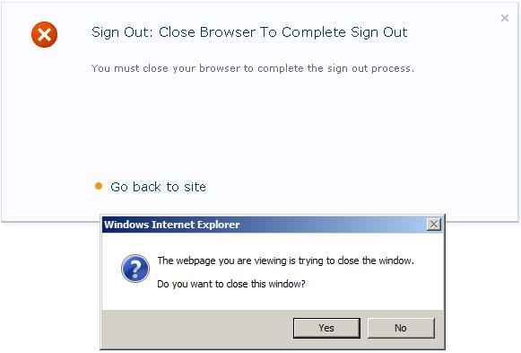
Sign Out Prompt
Notes:
When you select the “Sign Out” option from the Welcome Menu previously discussed, SharePoint redirects you to a helpful web page. The Sign Out confirmation web page explains that while you have signed out of SharePoint your SharePoint web pages may still be vulnerable until you close the web browser application window itself.
This is due to temporary internet page caching and session caching opportunities in popular web browser applications like Microsoft Internet Explorer or Firefox and powerful Enterprise web caching engines like Microsoft ForeFront or AraNetworks appliances. If someone else used the “Back” button in the browser it is possible, although unlikely, that they may be able to retrieve the previous SharePoint web page still authenticated as you!
Therefore, the SharePoint Sign Out web page contains code that initiates the web browser application to close the current window. If your web browser application is Internet Explorer with default security settings, a pop-up dialog box will prompt you to close the window.
NOTE: Some enterprise environments may configure Microsoft Internet Explorer to prevent automatic window closure from a web site or hide the pop-up prompt and simply go ahead and close the window. This prompt is the default behavior when IE has not been customized.

Slide 12
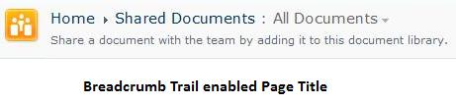

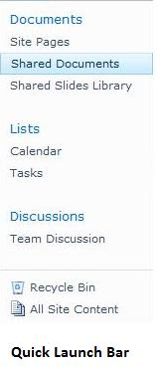
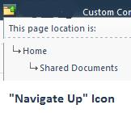
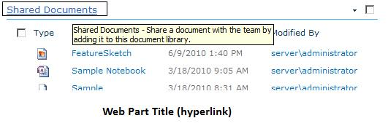
Navigating SharePoint
Notes:
SharePoint offers users many options for navigating between pages, lists and libraries within a site.
Breadcrumb Trail Page Title: can be used to navigate backward along the page path originally followed to reach the current display much like the “Navigate Up” icon only it is portrayed horizontally instead of vertically.
Top Link Bar Tabs (global navigation tabs) : tabs that are added dynamically by default for all sites in the site collection
“Navigate Up” Icon: can be used to navigate backwards up the site hierarchy much like a breadcrumb trail only it is portrayed vertically instead of horizontally
Quick Launch Bar (contextual current navigation links) : along the left edge of the page by default, the quick launch bar offers links to all lists, libraries and sub-sites within the site to which the browser is currently focused (by default)
Web Part Titles: the web parts on a page that expose a given list or library use hyperlinks as the web part title that can be engaged to navigate directly to the actual list or library being displayed.

Slide 13
DEMO
Introducing SharePoint 2010
Notes:
In this demonstration, your instructor will illustrate:
How to logon to a SharePoint site using Windows authentication via Internet Explorer.
How to use the Welcome Menu of SharePoint (including visiting each link).
How to navigate the home page of a SharePoint site using native tools.

Slide 14
Agenda
Introducing SharePoint
Logging in and Getting Around
SharePoint Components

Slide 15
SharePoint Components
Storing Information
Communicating
Automating information management
Notes:
SharePoint 2010 gives information workers several tools for storing and managing their data as well as communicating about that data. With so many tools, SharePoint could potentially become the main interface an information worker accesses to perform most of their daily duties.
Data storage advantages in SharePoint include document management features as well as web page content management features. Also, SharePoint stores all data (including uploaded files in libraries) in a Microsoft SQL Server 2008 database. By storing large documents in a database, you can maintain much more information about the documents beyond just file name, creation date, size, and simple attributes.
SharePoint also gives users the chance to stay updated about company, team or individual happenings quickly and easily. Various information such as meetings, appointments, contacts, announcements and more can be stored on a SharePoint site for multiple information workers to access. Furthermore, users can elect to be notified automatically by the SharePoint server about any new or changed information of their choice.
Additionally, data is often required to be processed according to business rules in the company. For example, travel reimbursement requests may require approval by the requesting employee’s supervisor. Or a manager may wish to receive an email whenever one of his or her subordinates performs certain actions in SharePoint.

Slide 16
Features of SharePoint
Lists
Libraries
Workspaces
Blogs
Wikis
Workflows
Notes:
SharePoint provides information workers several tools for managing data and communicating with others:
Lists: each list consists of configurable columns and editable rows (like a table or Excel spreadsheet) into which users enter values (each row of values constitutes an item in the list)
Libraries: an enhanced list that contains a file along with entered column values for each item
Workspaces: sub-sites designed to focus on a particular document or meeting, allowing users a separate web site in which they can work on a document prior to publishing it or organize meeting information prior to the meeting date
Blogs: sub-sites that support an individual or group blog
Wikis: special libraries of editable, related web pages used to communicate knowledge-base articles, brainstorming topics or any content that includes rich text elements such as pictures and hyperlinks
Workflows: business users can leverage the Windows Workflow Foundation support in SharePoint to automate repetitive or routine business processes that must be executed against certain content (such as documents in a library or items in a list)
Each of these Features will be discussed in further detail throughout the remaining modules of this course!

Slide 17
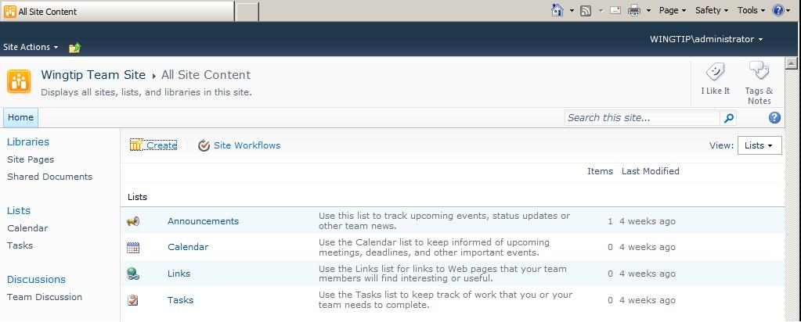
Lists
Notes:
Versatile and highly customizable, lists on a SharePoint site offer the administrator the ability to store metadata of choice without needing to support uploaded files. Several list templates are offered in the SharePoint Server 2010 family of products. More about lists will be discussed in other modules of this course.
Lists are a fundamental component in SharePoint. Almost everything you store in SharePoint as well as SharePoint objects the software itself uses to provide the platform are saved into lists. Lists are designed to hold metadata values that, all together, define a given business data entity. More about metadata appears in another module of this course.
Lists can be likened to tables. Lists consist of one or more columns, each of which demand a certain kind of data. To add business information to a list, you fill in the column fields for a given row to create a new item in the list (some folks may call the new item a “record” but that is a Microsoft Access term).

Slide 18
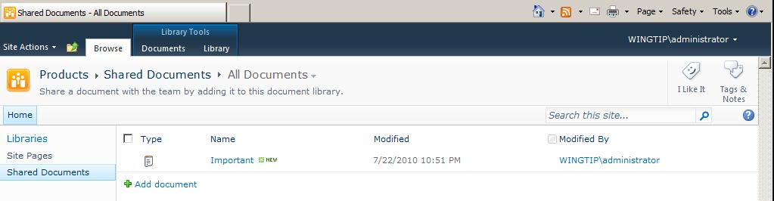
Libraries
Notes:
Libraries are a super-set of lists in that they can contain both metadata and the independent file the metadata defines. There are several library templates available in SharePoint 2010 to help you store whatever kind of files you need to manage. More about libraries will be discussed in other modules of this course.
Libraries offer document and content management features that are not available on all lists, such as item locking, folders, and version control. In fact, libraries are often more popular than lists because most companies already have a wealth of business information stored in the form of files on a network. Since it would be counter productive to have to re-enter all of that data again into a list, it’s more efficient to simply upload the file into a library and manage it from SharePoint.
Items can be added to libraries by either creating new files from scratch or by uploading existing files from a file system. Once a file is uploaded from the file system, you should encourage your co-workers to work only with the item in the SharePoint library and no longer interact with the file on the file system, because SharePoint 2010 will not keep the two file copies synchronized.

Slide 19
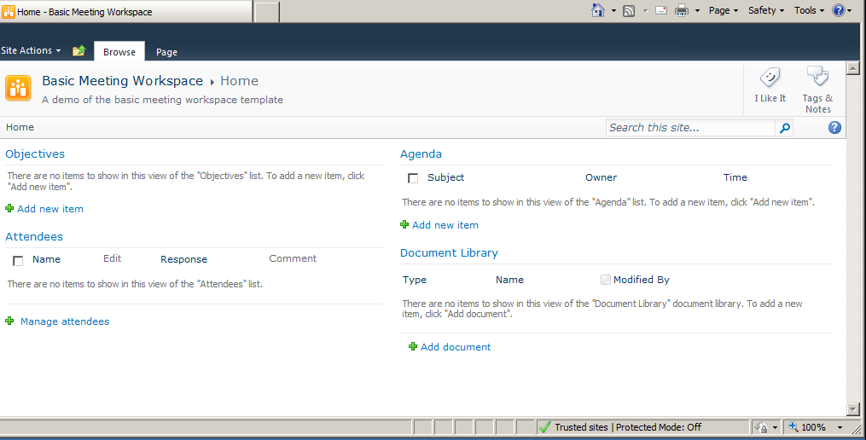
Workspaces
Notes:
Workspaces offer separate sites where a sub-group of business users can congregate and work on a given document/file or communicate about a particular meeting. SharePoint offers several workspace site templates (5 meeting workspace templates and one document workspace template). Site administrators can create the workspaces ahead of time and simply direct the information workers to link their library item or calendar event to the existing site.
Workspaces help organize supporting data that is used to create and edit a particular document or used to prepare for and conduct a specific meeting. Most of the data on a workspace is held in lists, just like any other site in SharePoint. You’ll learn more about workspaces later in this course.

Slide 20
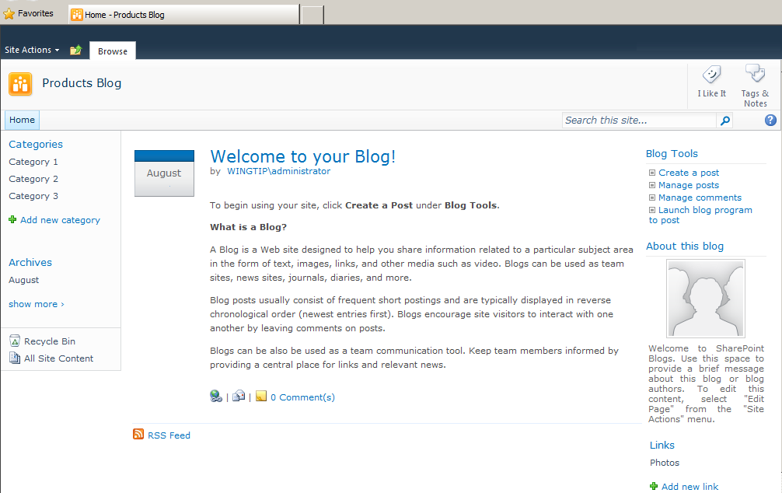
Blogs
Notes:
SharePoint 2010 offers Blog sites that can be authored by either a single user or a group of business information workers. Like many popular Internet blog providers, SharePoint provides visitors to a blog site the opportunity to subscribe for a RSS Feed of the blog, to submit comments to the posts, and to tag the blog with personal identifiers.
Community authored blogs give multiple business users the chance to brainstorm and collaborate via informal, short commentary. You’ll learn more about blogs later in this course.

Slide 21
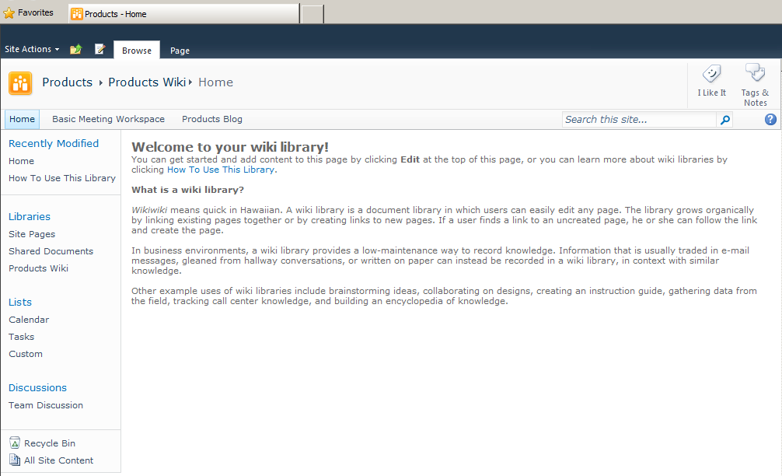
Wikis
Notes:
Another tool SharePoint 2010 offers for casual collaboration are Wikis. Wikis are collections of informal web pages that can contain richly formatted text, images, hyperlinks, and more. The pages are held in a Wiki Page library and can be connected to one another via navigation links to lend an intuitive navigation path through the content. Wikis can be authored by one or more business information workers.
The Wiki Page library housing the wiki can be located on an existing SharePoint 2010 site or on its own exclusive site. Other list types such as Contacts, Tasks or Links lists can be added to the site in which the wiki resides to add functionality for the wiki authors and readers. And of course wiki users can employ custom personal tags to the various wiki pages to quickly locate and use them.
Wiki Pages libraries offer all of the same content management features as other SharePoint 2010 libraries. You’ll learn more about wikis later in this course.

Slide 22
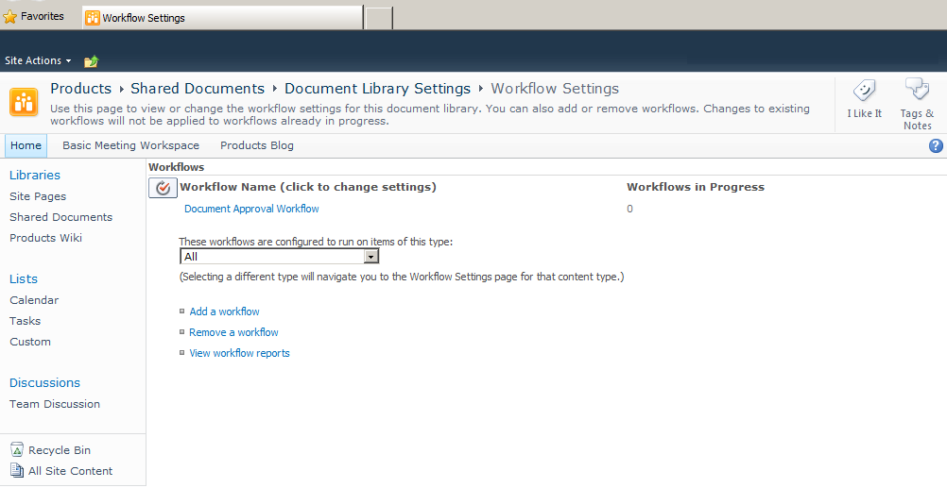
Workflows
Notes:
SharePoint 2010 takes advantage of a bit of Microsoft code that can be added to the Windows operating system of the server called the .NET Framework. This software adds programmability to the Windows OS and applications running on the server.
One component of the .NET Framework is the Windows Workflow Foundation (WF). The WF allows SharePoint 2010 to business users the option of automating business processes that must take place for list and library items. One example of a simple workflow is the Approval Workflow template. This workflow can be executed against items when they are created or changed. The workflow can be configured to create a series of tasks in a Tasks list that will notify personnel of the item’s status and require approvers to either approve or reject the item.
Workflows can be quite simple or very complex. They can be created directly on the list or can be constructed for a content type object in SharePoint that may then be associated with multiple lists. Workflows can even be created at the site level to be employed against various lists on the site. Simple workflows can be created by using templates in the web browser.

Slide 23
DEMO
Working with Lists and Libraries
Notes:
In this demonstration, your instructor will illustrate:
How to engage lists and libraries for the purposes of both reading and contributing.
How to communicate with coworkers in SharePoint.

Slide 24
Summary
Introducing SharePoint
Logging in and Getting Around
SharePoint Components
Notes:
In this module, you learned the purpose of SharePoint in your company and how to sign-in and navigate a Microsoft SharePoint 2010 web site. We discussed various features of a SharePoint site that are useful to information workers and explored the predominant lists, libraries and sub-sites employed by business users to organize, share, and communicate about company information.

